Slide 1
Substitution and Elimination Reactions

Slide 2
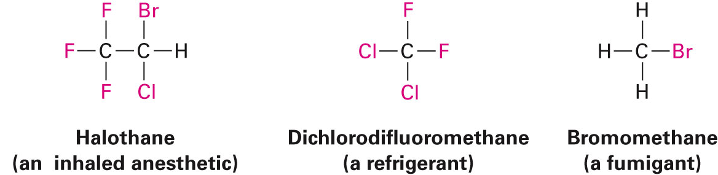
Alkyl Halides
Contain F, Cl, Br, or I
Widely used in:
Synthesis (electrophilic carbon and easy functional group transitions)
Solvents (CCl₄, CHCl₃, CH₂Cl₂)
Industrial applications
Structure:

Slide 3
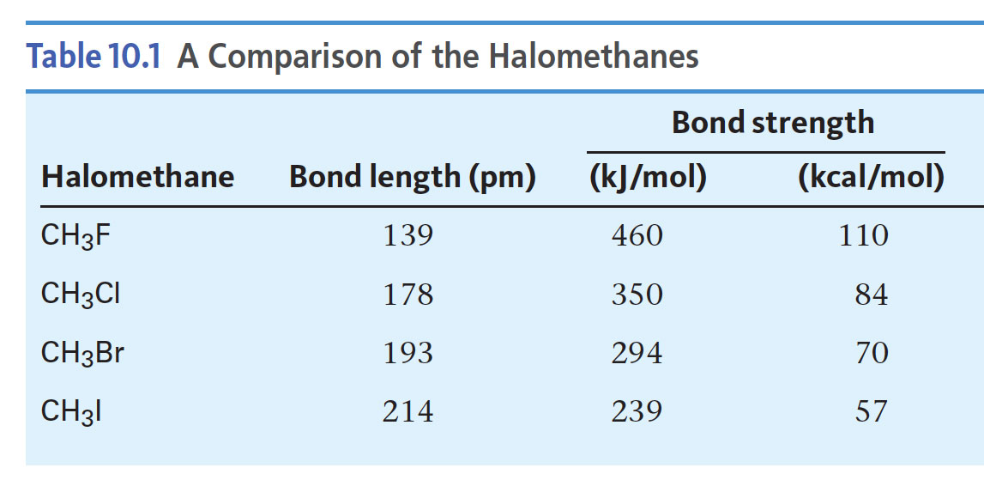
Alkyl Halides: Properties
Bond strength
Measured by bond dissociation energy
Inversely proportional to bond length
Electronegativity and small size of F keep bonding electrons close
C-F > C-Cl > C-Br > C-I
short long
strong weak

Slide 4
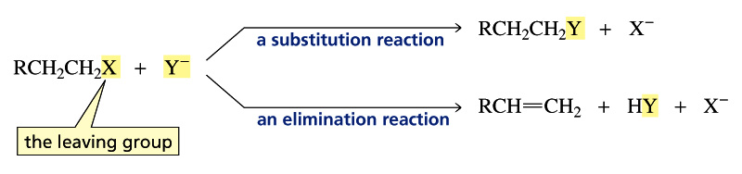
Alkyl Halides: Reactions
Carbon bonded to X is electron-poor (electrophilic)
Will react with nucleophiles
Nucleophiles are also bases! So, there are two competing reactions:
Substitution
Nucleophile substitutes for X (the leaving group)
Elimination
Nucleophile/base removes H, eliminates HX to yield an alkene

Slide 5
Learning Goals
Mechanisms of substitution
Mechanisms of elimination
Substitution vs. Elimination

Slide 6
Nucleophilic Substitution
Example:
CH₃CH₂CH₂Br + NaOCH₃ → CH₃CH₂CH₂OCH₃ + NaBr
Possible Mechanisms:

Slide 7
Evidence for Different Mechanisms
How can we explain the observed stereochemistry?
There is more than one possible mechanism
S_{N}2 and S_{N}1 (differ in timing of C-X breaking and C-Nu formation)

Slide 8
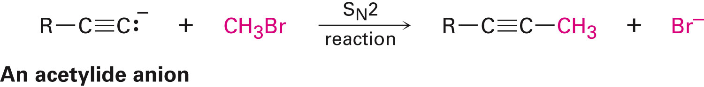
The S_{N}2 Reaction
Bimolecular nucleophilic substitution
Bimolecular = two species (RX and Nu) participate in RDS
Rate = k [RX] [Nu]
Mechanism:
Single step
No intermediates
Bonds broken and made simultaneously (concerted)
Same mechanism applicable to carbon nucleophiles (acetylide ion and methyl/primary RX)

Slide 9
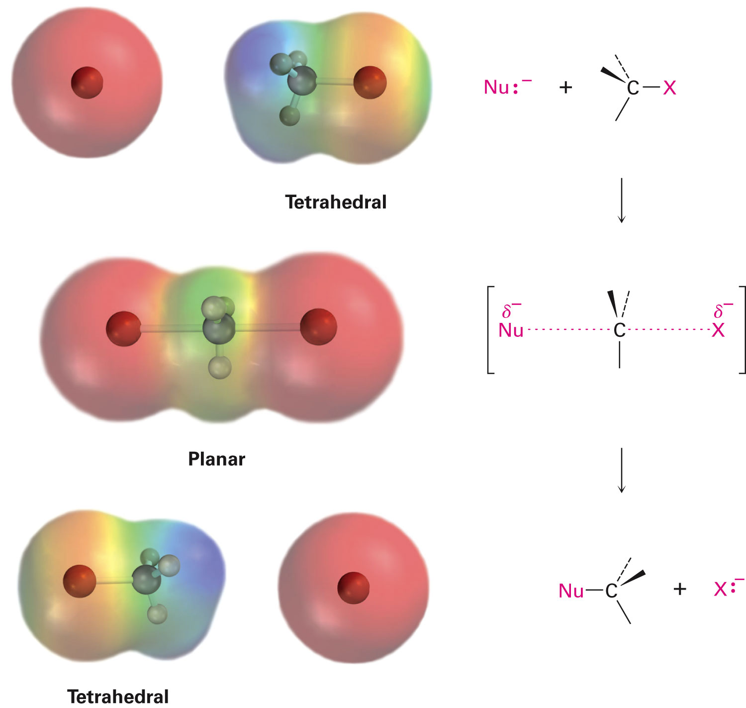
The S_{N}2 Reaction: Transition State

Slide 10
Experimental Evidence for the S_{N}2 Reaction
The rate of the reaction is dependent on the
concentration of the alkyl halides and the nucleophile
The rate of the reaction with a given nucleophile
decreases with increasing size of the alkyl halides
The configuration of the substituted product is
inverted compared to the configuration of the reacting
chiral alkyl halide

Slide 11
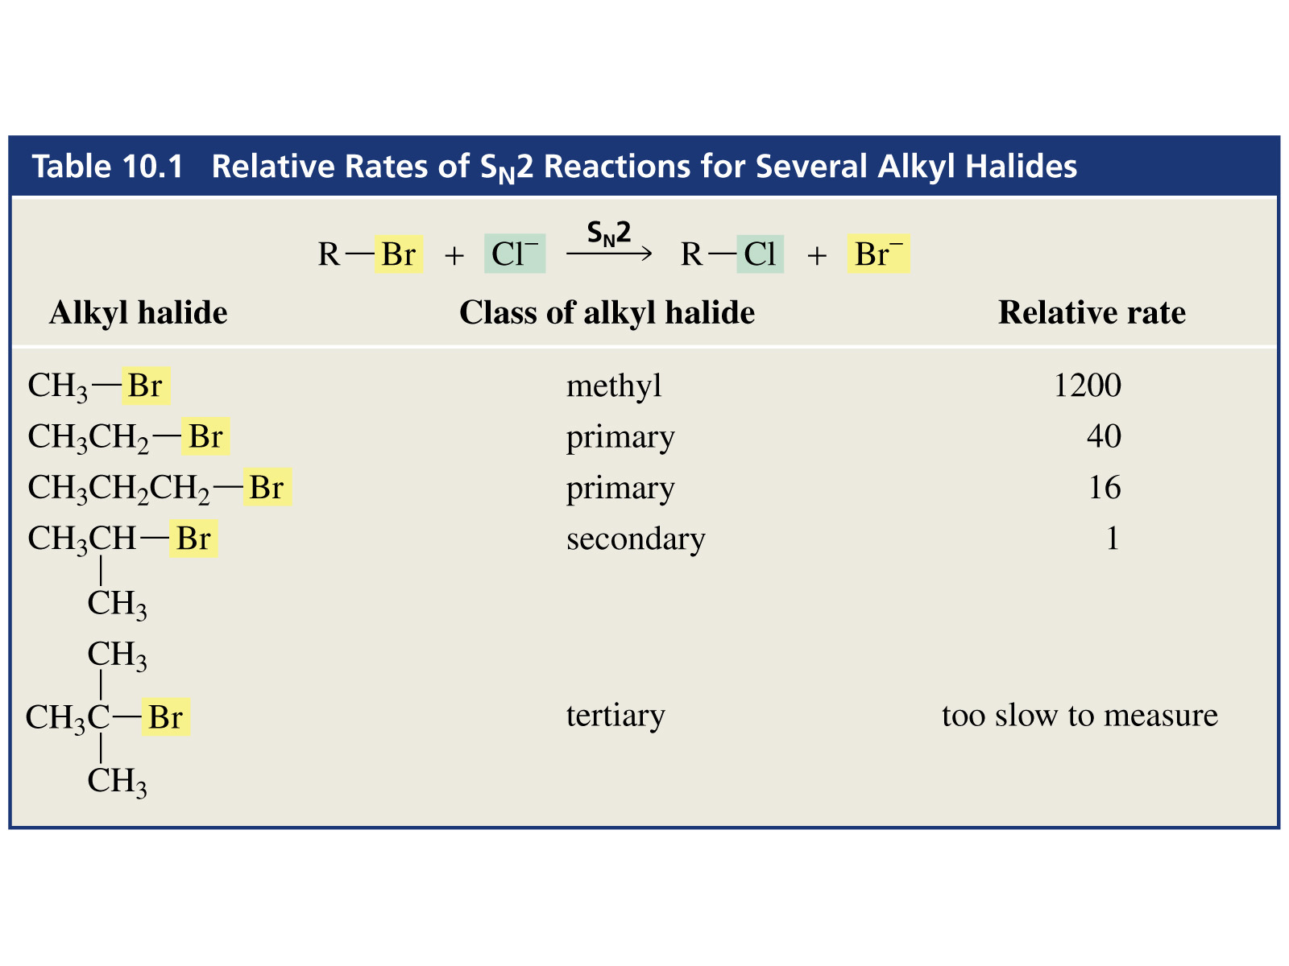
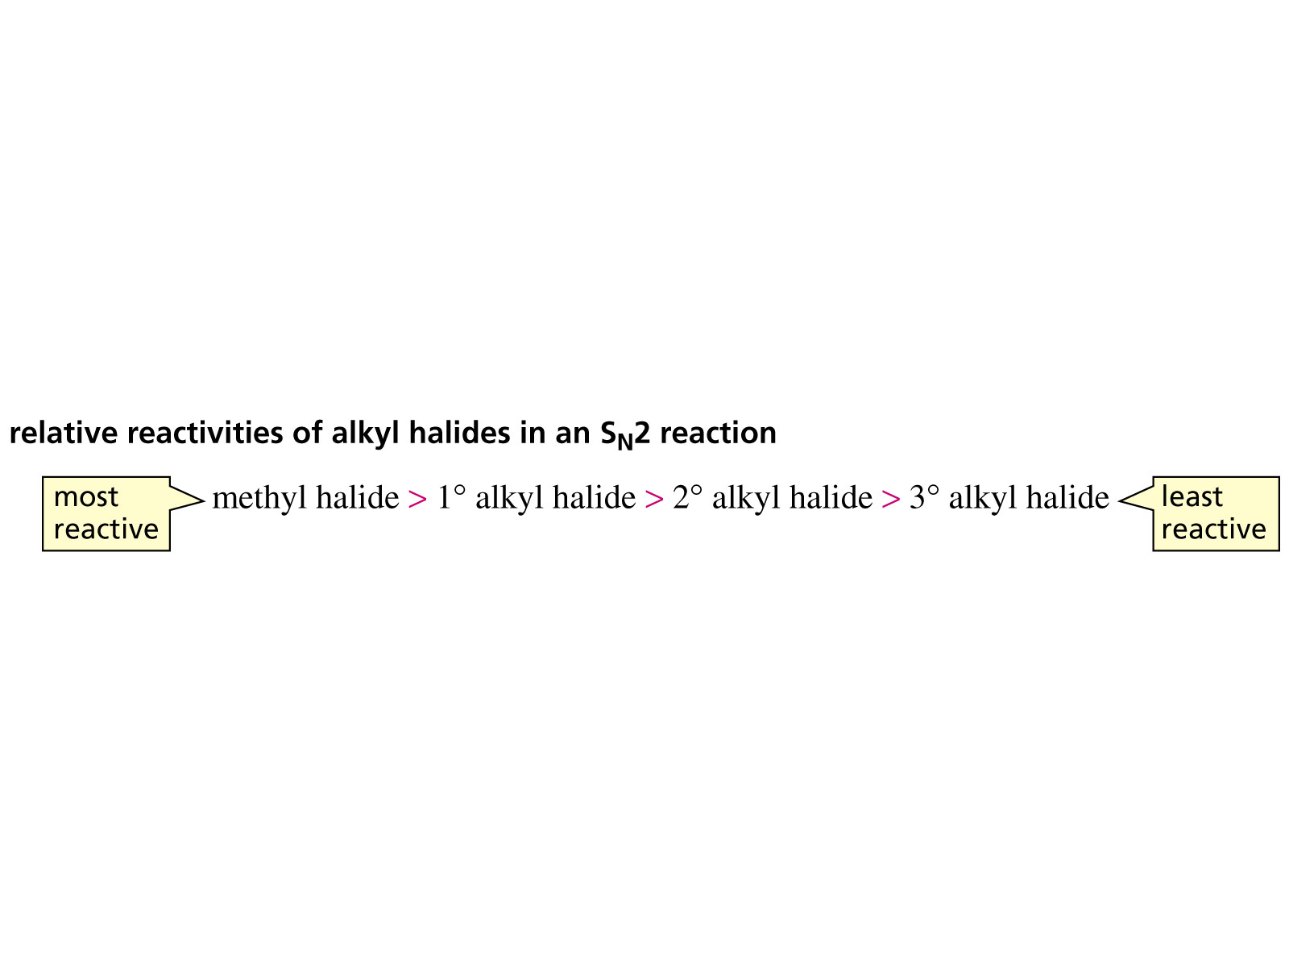
S_{N}2 Reaction: Effect of Alkyl Halide Structure

Slide 12
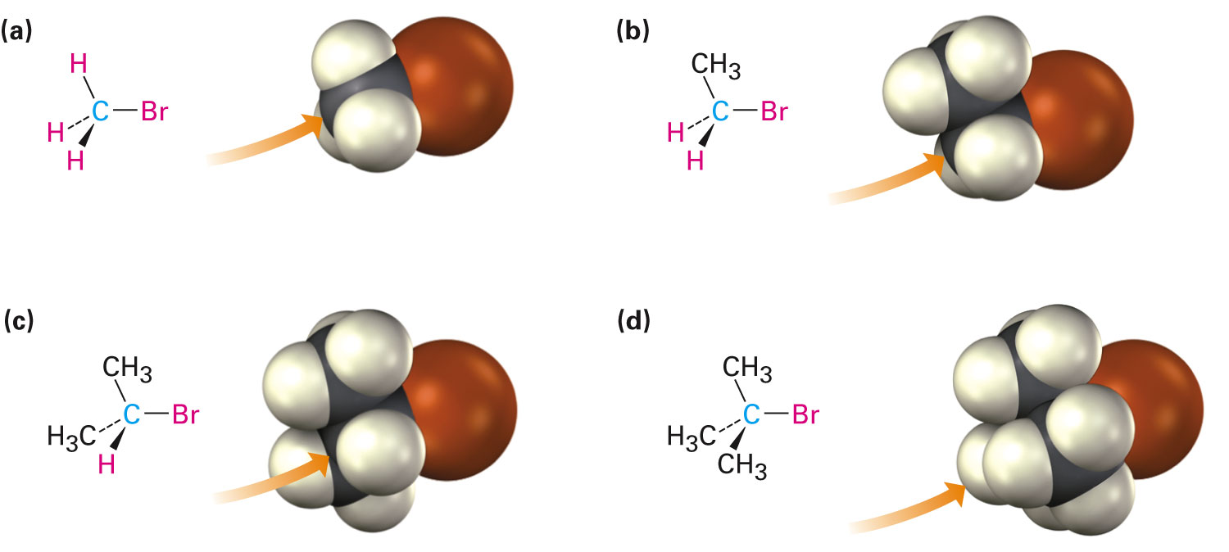
S_{N}2 Reaction: Effect of Alkyl Halide Structure
Steric effects
Nucleophile must have access to reaction center
Access is hindered with bulky substituents

Slide 13
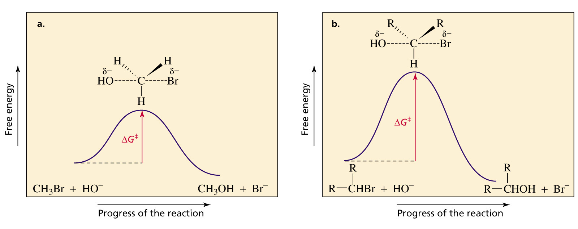
S_{N}2 Reaction: Energy Profile Diagram
Single step
No intermediates
Bonds broken and made simultaneously (concerted)

Slide 14
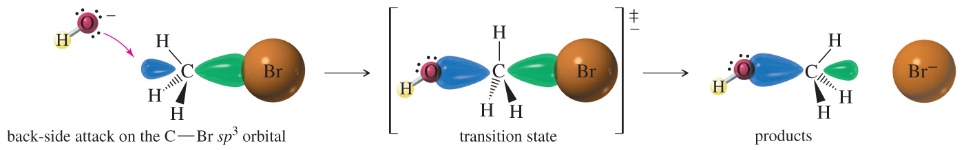
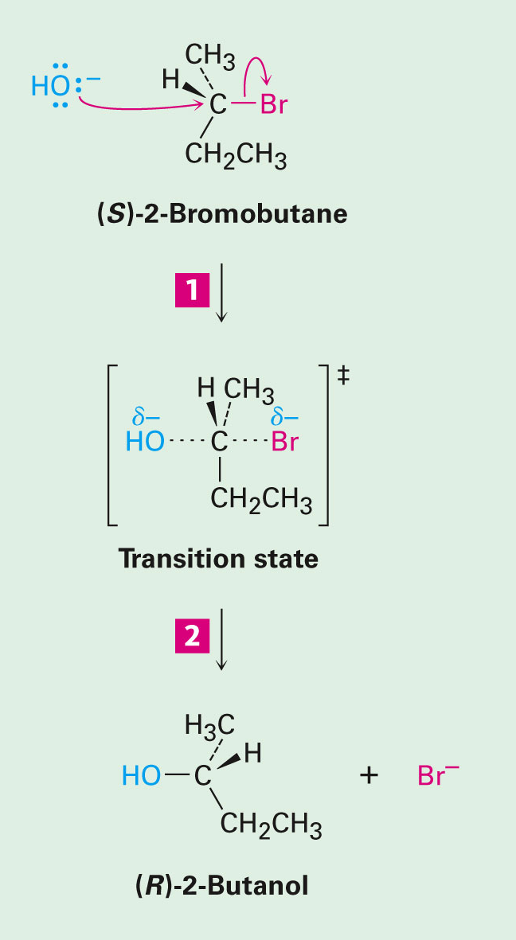
Back-Side Attack in the S_{N}2 Reaction
Inversion in stereochemistry if precursor is chiral
(R) and (S) are just names. Don’t rely on names to determine the stereochemistry of a reaction.
Notes:
File Name: AACXSGA0

Slide 15
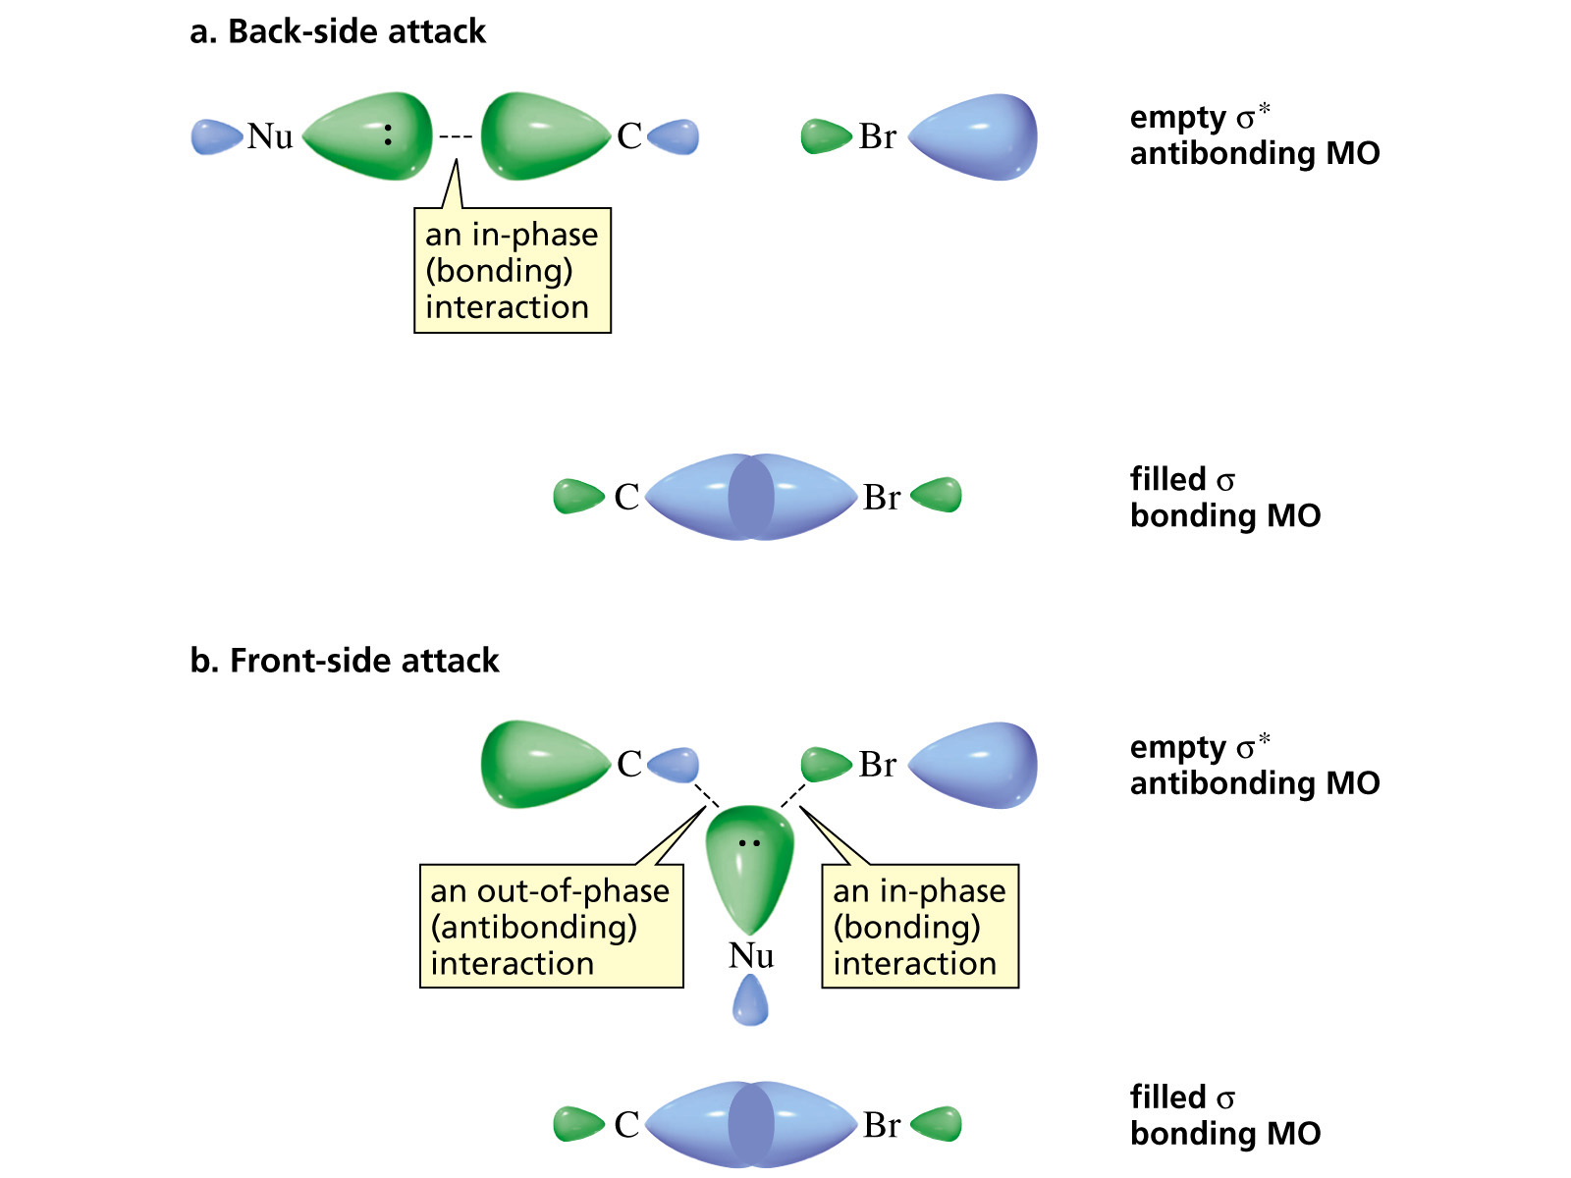
S_{N}2 Reaction: Reason for Stereochemical Course

Slide 16
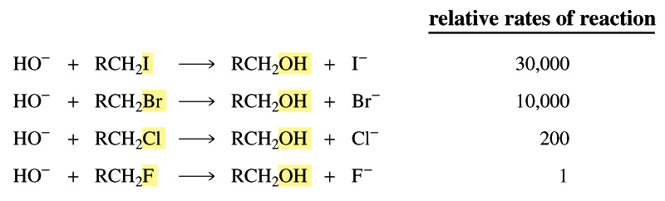
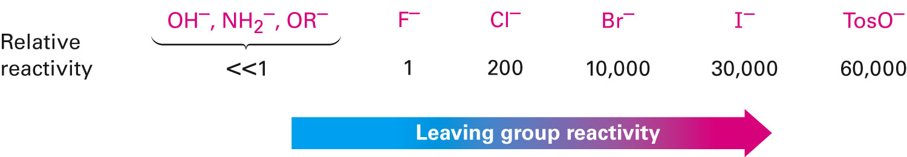
S_{N}2 Reaction: Effect of the Leaving Group
Better leaving group results in a faster reaction

Slide 17
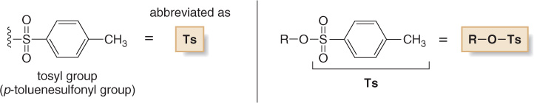
What Constitutes a “Good” Leaving Group?
A leaving group that can stabilize negative charge better will be
a better leaving group.
Remember: Charge delocalization is an important indicator of
relative stability

Slide 18
S_{N}2 Reaction: Effect of the Nucleophile
Nucleophile: contains lone pair
Some nucleophile are better than others
Better nucleophile = faster S_{N}2 reaction
Some common nucleophiles:
What trends do you notice relating nucleophilicity and
structure?
Poor | Good | Strong
ROH RCO₂H H₂O F⁻ | RCO₂⁻ RSH NH₃/NR₃ Cl⁻ Br⁻ | I⁻ HS⁻ HO⁻ RO⁻ CN⁻

Slide 19
S_{N}2 Reaction: Effect of the Nucleophile
Anions are stronger nucleophiles
than neutral molecules
Poor | Good | Strong
ROH RCO₂H H₂O F⁻ | RCO₂⁻ RSH NH₃/NR₃ Cl⁻ Br⁻ | I⁻ HS⁻ HO⁻ RO⁻ CN⁻
stronger base,
better nucleophile
weaker base,
poorer nucleophile
OH– > H₂O
CH₃O– > CH₃OH
–NH₂ > NH₃
CH₃CH₂NH– > CH₃CH₂NH₂

Slide 20
S_{N}2 Reaction: Effect of the Nucleophile
Less stable anions are stronger nucleophiles than more stable anions
RO⁻ > RCO₂⁻
Nucleophilicity decreases from left to right in the periodic table
Increases down periodic table, as size and polarizability increase

Slide 21
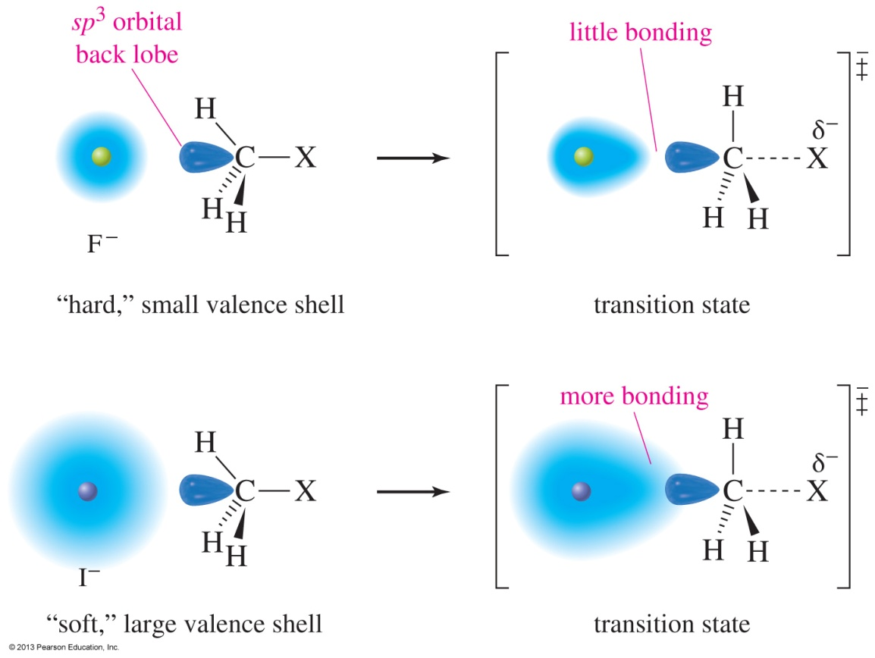
Polarizability

Slide 22
S_{N}2 Reaction: Nucleophilicity vs Basicity
Bulky anions are more likely to act as a base, rather than a nucleophile
(CH₃)₃CO⁻ vs. CH₃O⁻
base nucleophile
Steric hindrance (bulkiness)
hinders nucleophilicity
more than it hinders basicity.

Slide 23
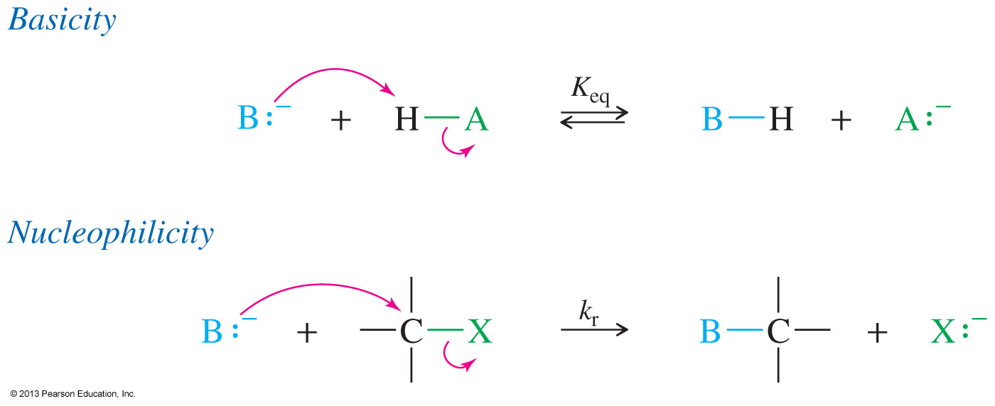
Nucleophilicity vs Basicity
Nucleophilicity is a measure of how readily a compound (a nucleophile) is able to attack an electron-deficient atom
Nucleophilicity is measured by a rate constant (k)
Basicity is a measure of how well a compound (a base) shares its
lone pair with a proton
Basicity is measured by the acid dissociation constant (K_{a})

Slide 24
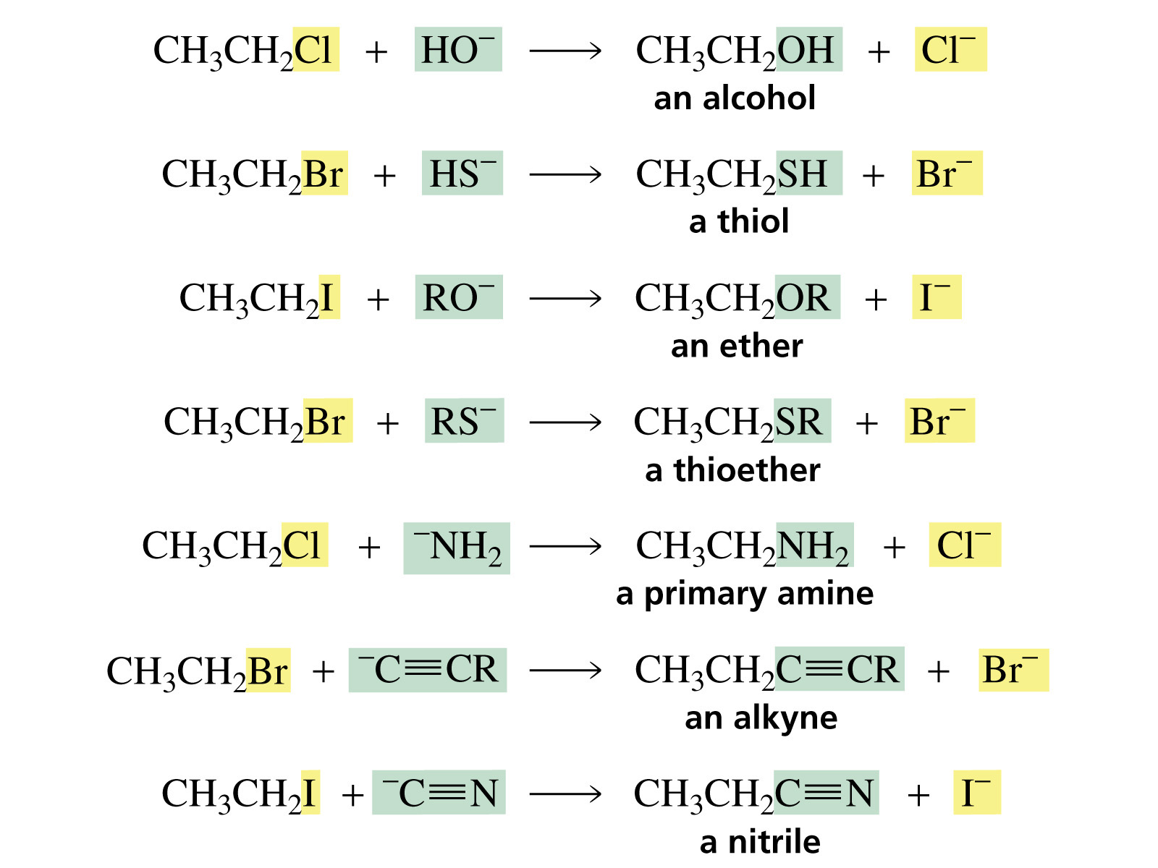
Basicity and Leaving Group Ability
An S_{N}2 reaction proceeds in the direction that allows the strongest base to displace the weaker base

Slide 25
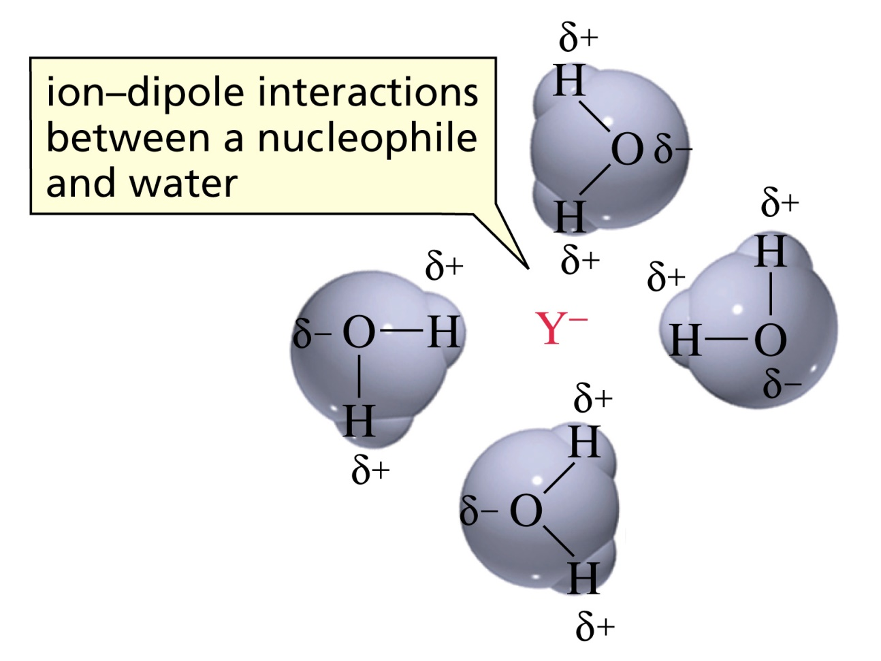
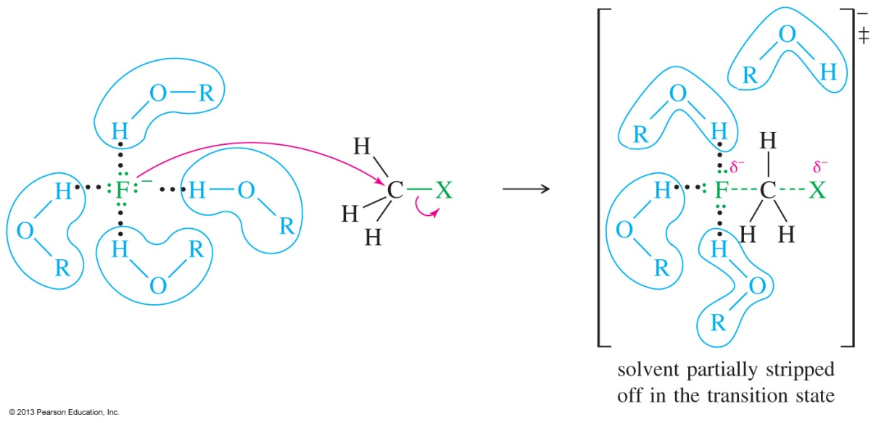
Nucleophilicity is Influenced by Solvent
Polar protic solvents have acidic hydrogens (O—H or N—H) that can solvate the nucleophile, reducing their nucleophilicity.
Nucleophilicity in protic solvents increases as the size of the atom increases (more diffused negative charge leading to less effective solvation)

Slide 26
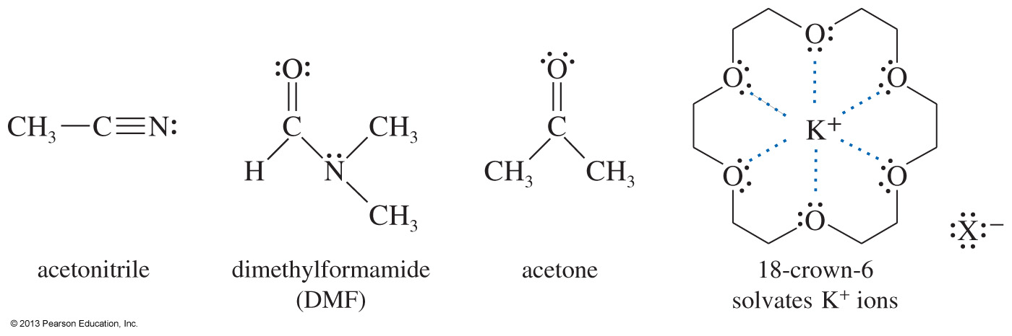
Polar Aprotic Solvents are Good for S_{N}2 Reactions
Polar aprotic solvents do not have acidic protons and therefore cannot hydrogen bond.
Some aprotic solvents are acetonitrile, DMF, acetone, and DMSO.
S_{N}2 reactions proceed faster in aprotic solvents.
Polar aprotic solvents solvate cations, but not anions
Anions are less solvated and hence more available to react as nucleophiles

Slide 27
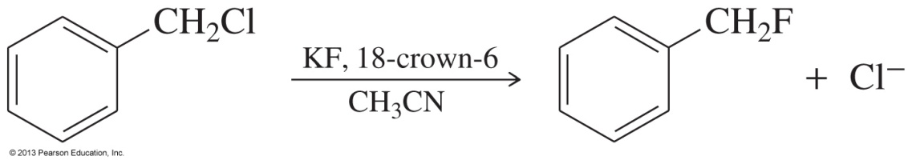
Influencing Solvation as a Practical Tool
There are special chelating compounds for cations which enhance the nucleophilicity of an otherwise less nucleophilic anion.
Crown ethers solvate the cation, so the nucleophilic strength of the anion increases.
Fluoride can become a good nucleophile.

Slide 28
S_{N}2 Summary
Rates of Reaction (Kinetics): What is the rate-determining step for the S_{N}2 reaction? Does the rate of reaction depend on the concentration of alkyl halide only OR both the alkyl halide and nucleophile?
Stereochemistry: What happens to a stereocenter (chirality center) during the course of this reaction?
Structure of the Alkyl Halide: List alkyl halide type (1°, 2°, 3°) in order of decreasing ability to undergo this type of substitution reaction. Are there any types of alkyl halides that do not undergo this type of reaction? Why? Given this order or reactivity, are electronic factors important for this reaction? Why or why not? Are steric factors important for this reaction? Why or why not?
The Nucleophile: Is the nature of the nucleophile important for the S_{N}2 reaction? Why or why not?
The Leaving Group: Rank the leaving groups of alkyl halides (F⁻, Cl⁻, Br⁻, I⁻) in their ability to “leave.” Why is this trend observed?
The Solvent: How do polar aprotic solvents and polar protic solvents affect substitution reactions? What are the best solvents for the S_{N}2 reaction? Why?

Slide 29
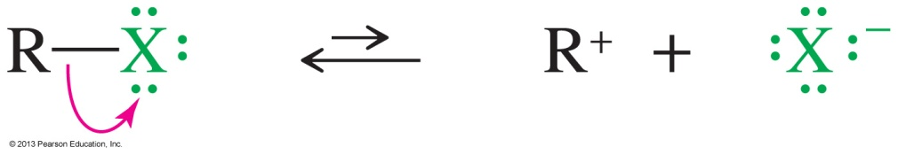
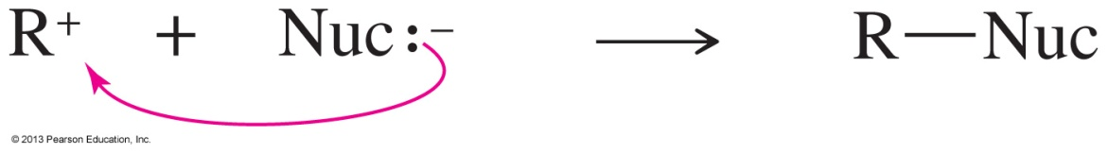
S_{N}1 Reactions
The S_{N}1 reaction is a unimolecular nucleophilic substitution.
It has a carbocation intermediate.
Rate = k_{r}[alkyl halide].
If precursor is enantiopure, racemization occurs.
Step 1: Formation of the carbocation.
Step 2: Attack of the nucleophile.

Slide 30
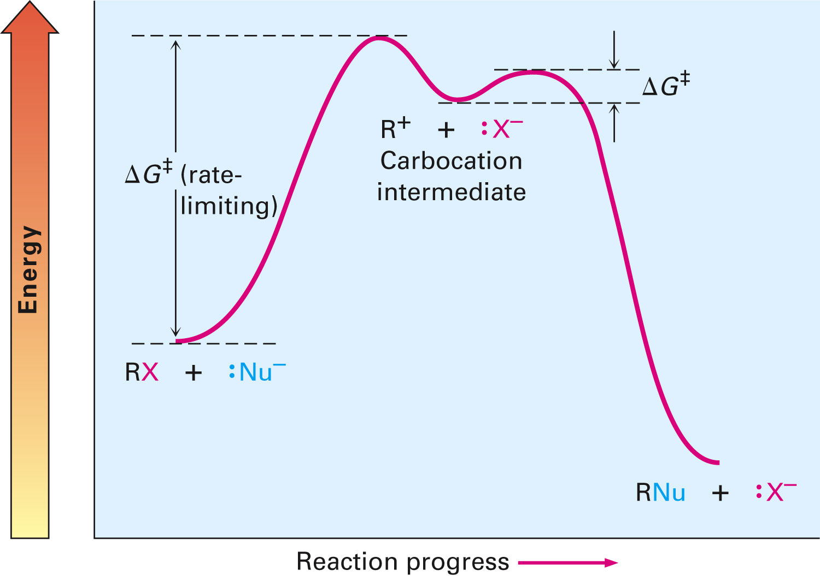
S_{N}1 Reaction: Energy Profile Diagram

Slide 31
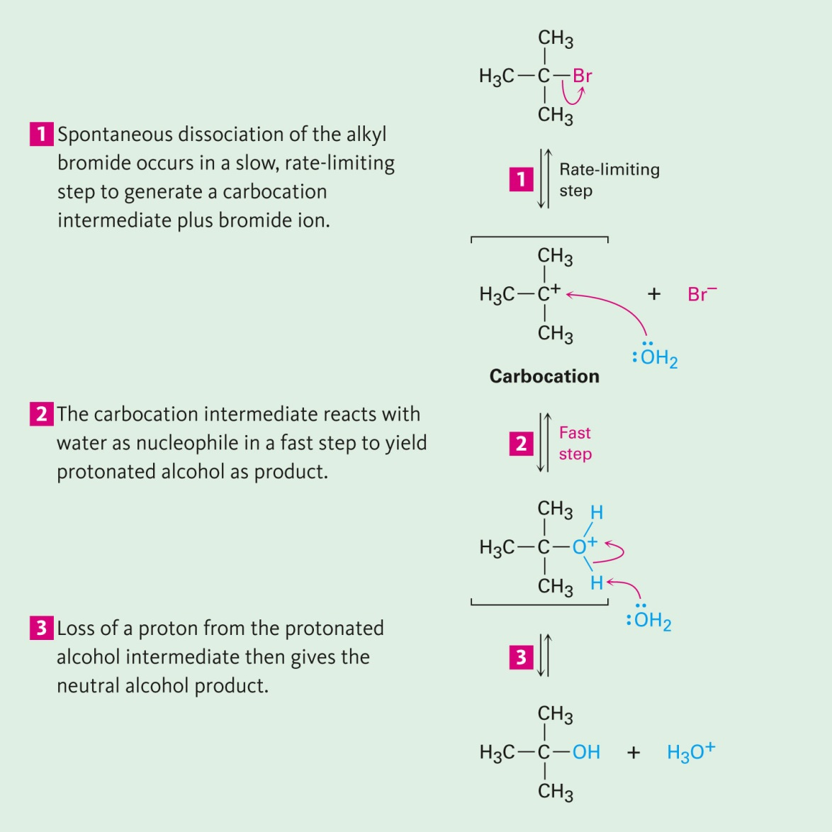
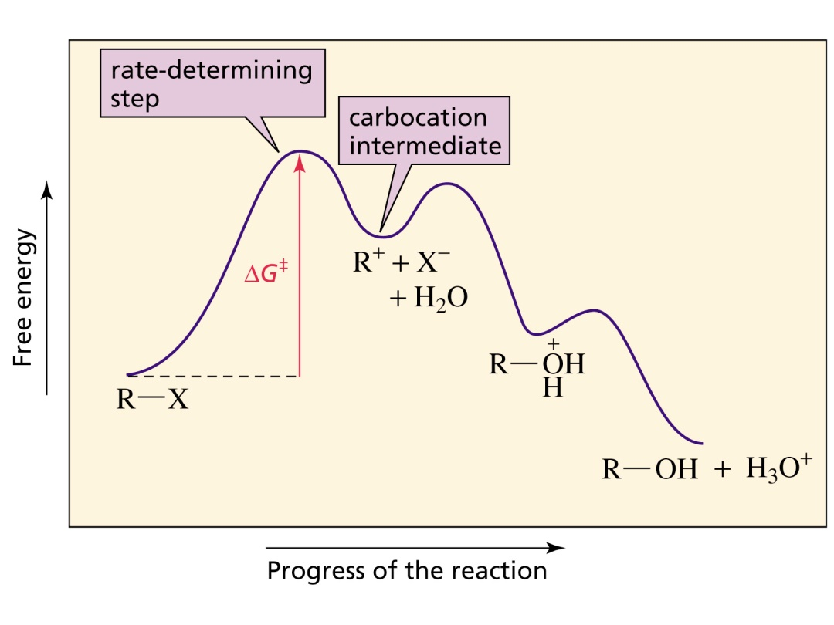
S_{N}1 Reaction: Energy Profile Diagram

Slide 32
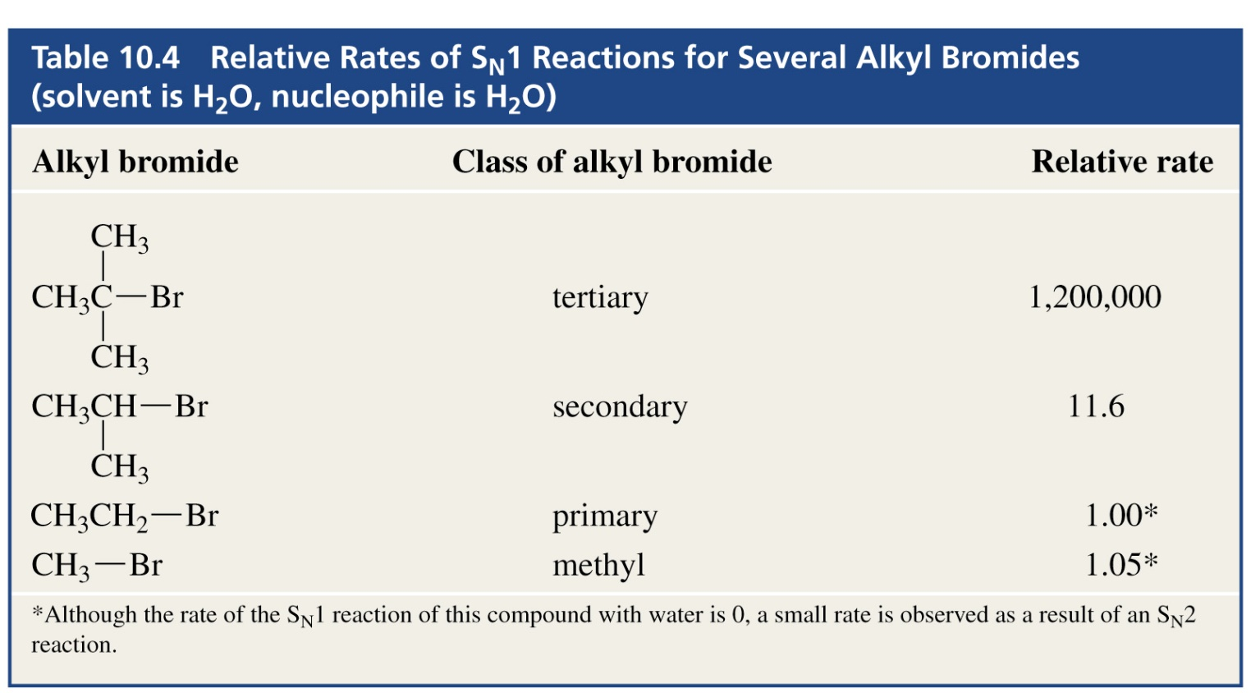
S_{N}1 Reaction: Effect of Alkyl Halide
From what we have learnt about substitution reactions so far, you would expect that the reaction of t-butyl bromide with water would be slow
water is a poor nucleophile
t-butyl bromide is sterically hindered
However
Reaction is a million times faster than with CH₃Br

Slide 33
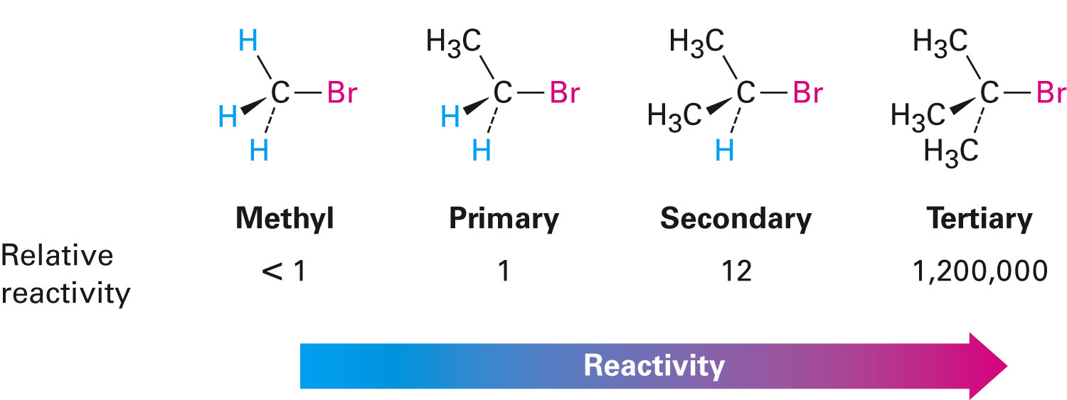
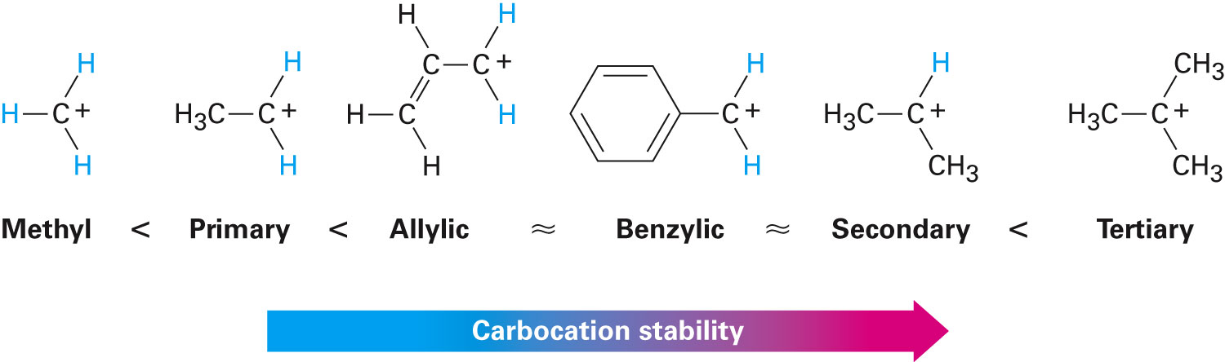
S_{N}1 Reaction: Effect of Alkyl Halide
Electronic effects
More stable carbocation = faster reaction
Remember carbocation stability

Slide 34
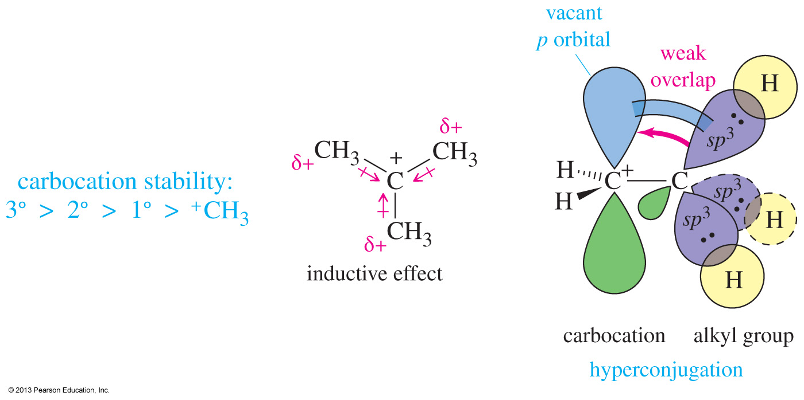
Carbocation Stability

Slide 35
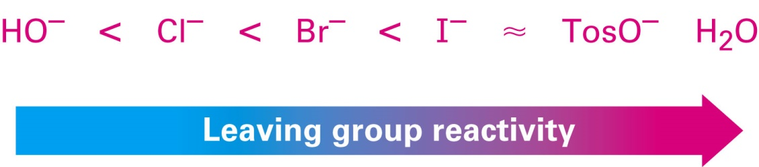
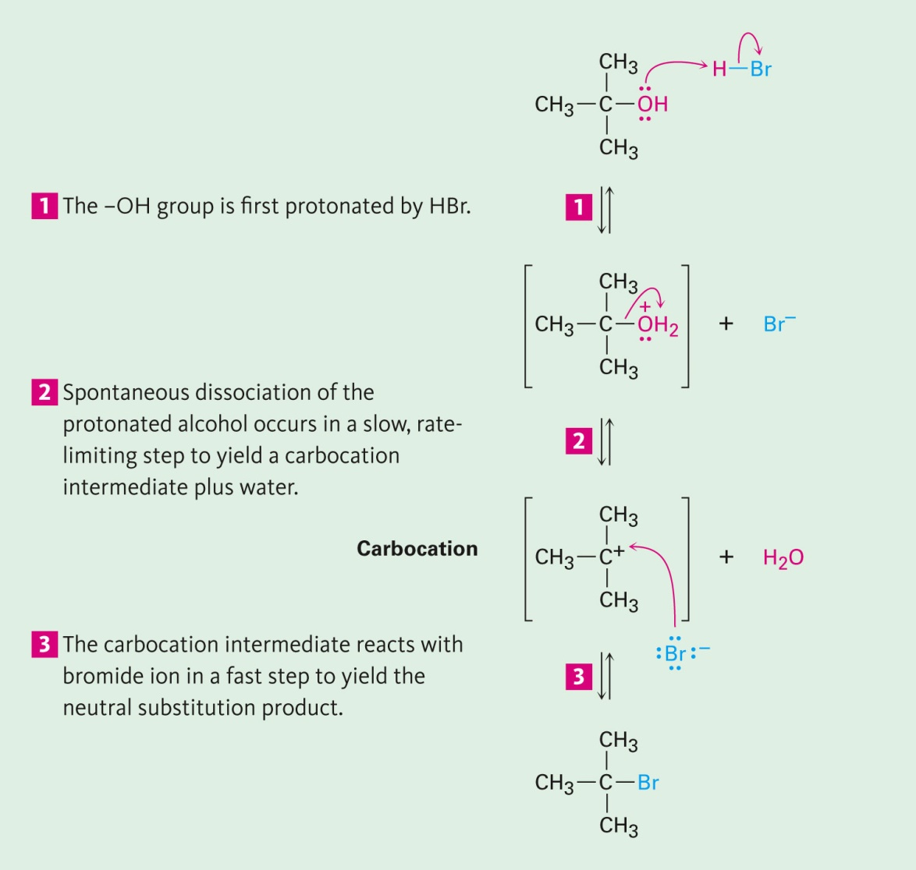
S_{N}1 Reaction: Effect of Leaving Group
Better leaving group leads to faster reaction
A poor leaving group
can be converted into a good one
S_{N}1 on alcohols
Need strong acid to protonate –OH and form a better LG

Slide 36
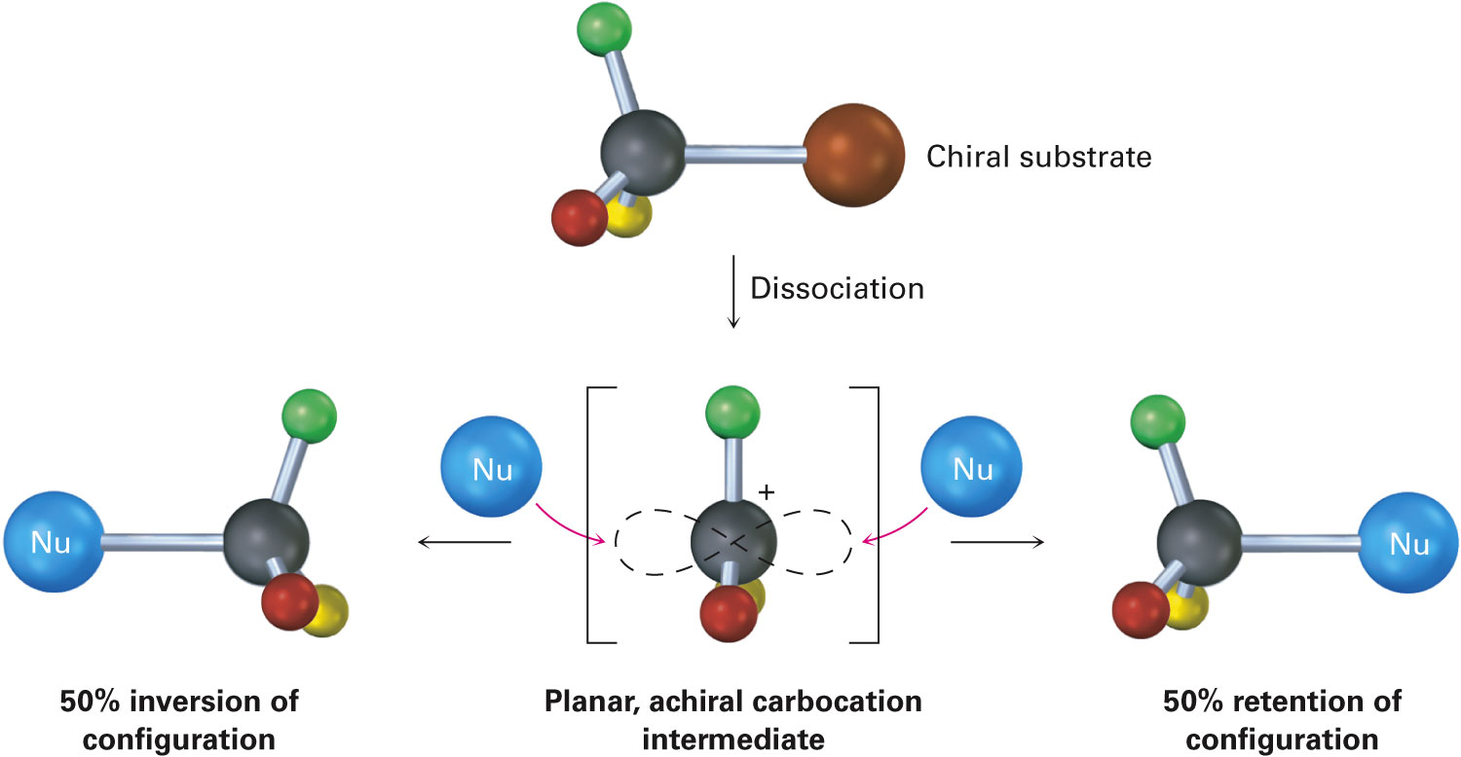
S_{N}1 Reaction: Stereochemistry
Racemic mixture
50% inversion of configuration
50% retention of configuration
Why? Consider the intermediate…

Slide 37
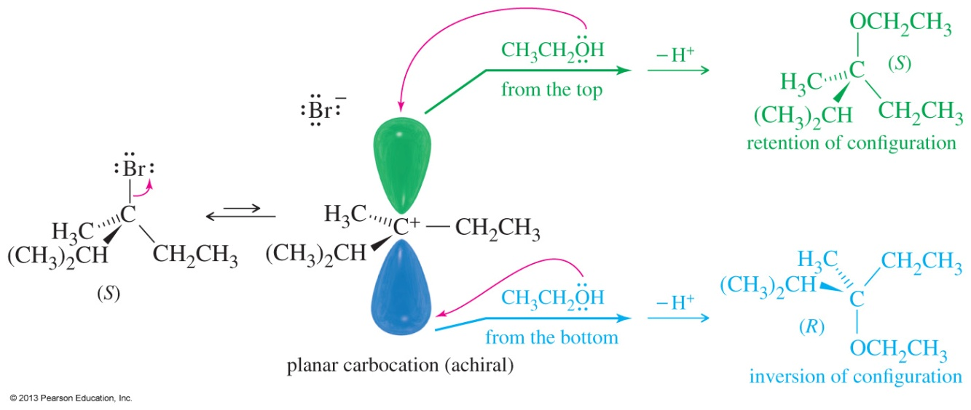
S_{N}1 Reaction: Stereochemistry
Carbocations are sp² hybridized and trigonal planar. The lobes of the empty p orbital are on both sides of the trigonal plane.
Nucleophilic attack can occur from either side, producing mixtures of retention and inversion of configuration if the carbon is chiral.

Slide 38
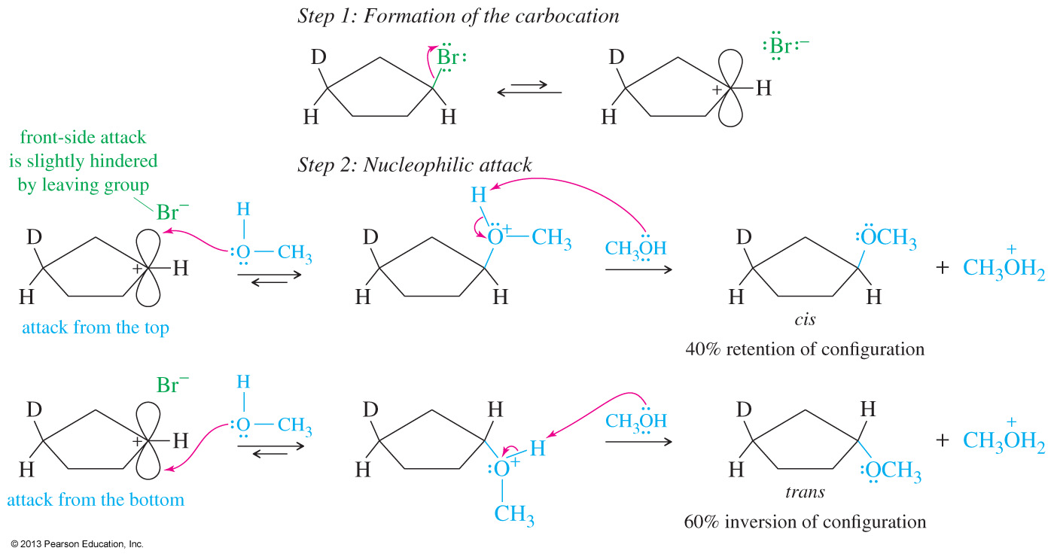
S_{N}1 Reaction: Stereochemistry

Slide 39
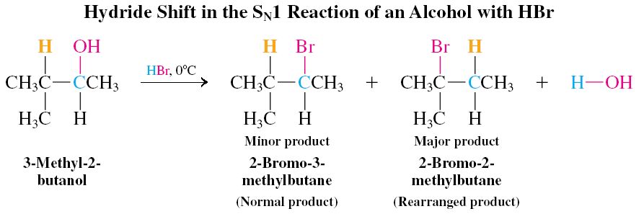
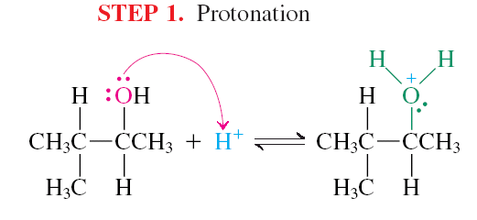
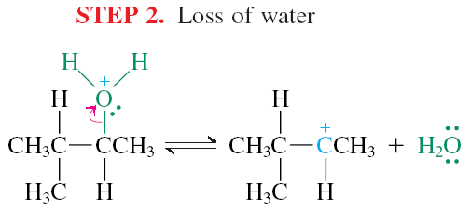
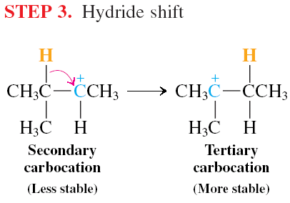
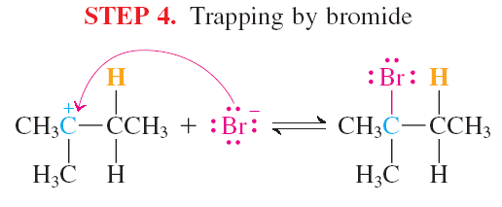
Carbocations can Undergo Rearrangement

Slide 40
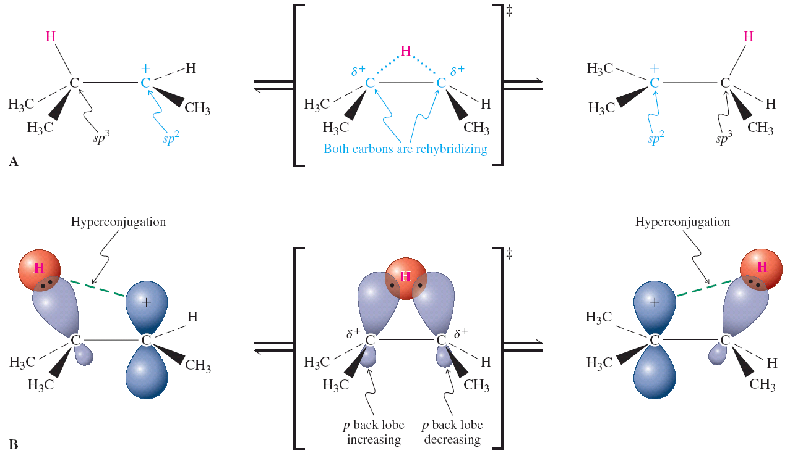
Carbocations can Undergo Rearrangement
Hydride shifts are very fast (faster than S_{N}1 or E1) which is partially due to hyperconjugation in the carbocation weakening the C-H bond)

Slide 41
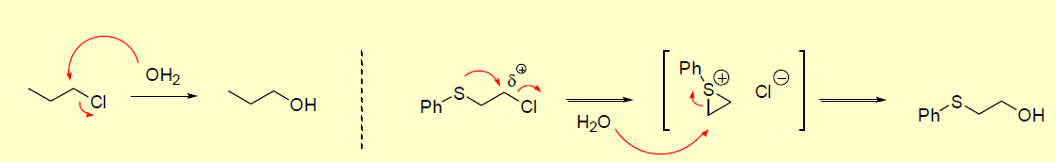
Substitution Reactions: Neighbouring Group Assistance
(Anchimeric Assistance)
Groups remote from a reaction centre can participate in substitution reactions – Neighboring Group
Participation (NGP) (or anchimeric assistance):
lone pairs of electrons, typically on N, O, S or halogen atoms interact with electron deficient/cationic centres
Relative rate 1 : 600

Slide 42
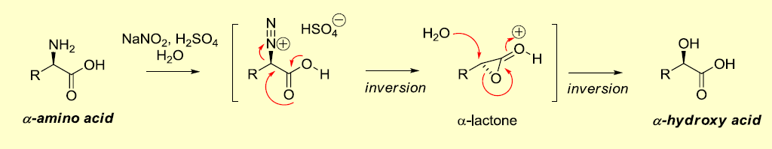
Neighbouring Group Participation
NGP can also manifest as a stereochemical outcome.
Remember that we have seen mechanisms that either cause inversion or racemization…..but never retention!
In this case, retention is a result of double inversion.

